Slide 1

LEVERAGING MULTIOMICS DATA FOR PERSONALIZED LUNG CANCER PROGNOSIS THROUGH INTEGRATED HEALTH PROFILES
24-25J-211
NSCLC360
Project ID: 24-25J-211

Slide 2


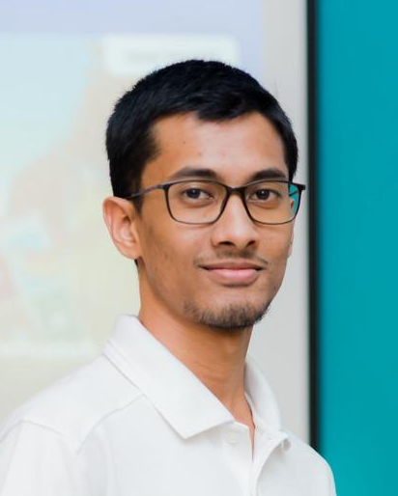




Waseek M.L
IT21374524
Arudchayan P
IT21190698
Irfan N.A.A
IT21331022
AHAMED A.S.S
IT2342226
Dr. Nuradh Joseph
External Supervisor
Mr. Samadhi Rathnayake Supervisor
Ms.Thisara Shyamalee
Co-Supervisor
Project ID: 24-25J-211
2025/03/19

Slide 3
INTRODUCTION
RESEARCH ǪUESTION
SYSTEM DIAGRAM
COMPONENTS
Project ID: 24-25J-211

Slide 4
Introduction
What is Prognosis?
Prognosis refers the understanding of a likely course and outcome of a disease based on the current health status, disease characteristics and response to treatment.
What is NSCLC?
Non-Small Cell Lung Cancer (NSCLC) is a particularly deadly form of lung cancer, primarily because it often remains asymptomatic until it has reached an advanced stage. The treatment options for NSCLC vary based on the stage of the cancer and the individual characteristics of the patient.
Project ID: 24-25J-211

Slide 5
Research Ǫuestions?
How can multimodal machine learning models improve early lung cancer detection and treatment while ensuring medical data privacy?
How can a quantitative approach leveraging omics data enhance prognostic analysis in non-small cell lung cancer?
How can we accurately predict NSCLC side effects using patient-specific data and advanced modeling to optimize treatment outcomes?
How can deep learning models predict NSCLC recurrence by integrating imaging, genomic, proteomic, and clinical data?
Project ID: 24-25J-211

Slide 6
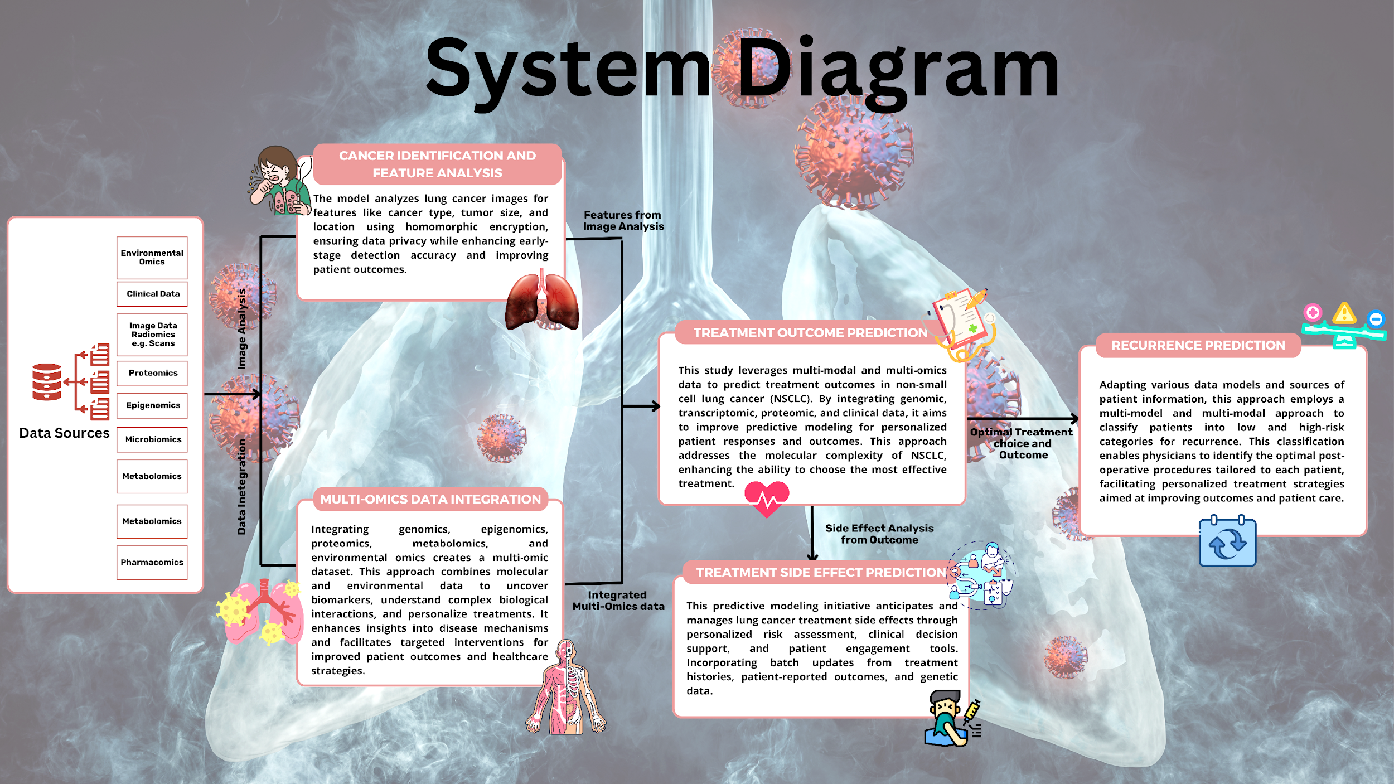
Project ID: 24-25J-211

Slide 7
IT21374524 | WASEEK M.L.
BSc (Hons) Information Technology Specializing in Data Science Secure
Advanced Deep Learning for Early Lung Cancer Detection and Feature Extraction
IT21374524 | Waseek M.L.
Project ID: 24-25J-211
2025/03/19

Slide 8
Research Ǫuestion
How can advanced machine learning models, through multimodal analysis and data integration and treatment of lung cancer ?
IT21374524 | Waseek M.L.
2025/03/19

Slide 9
Specific Sub-Objectives
Dataset & Model Setup – Successfully selected LIDC-IDRI & TCIA datasets and implemented ResNet-50 for feature extraction. ✅
Tumor & Pathology Extraction – Extracted tumor location and TNM pathology features from DICOM PET/CT scans. ✅
improve feature extraction and classification accuracy. Hyperparameter tuning and advanced augmentation techniques should also be explored. ❌
IT21374524 | Waseek M.L.
2025/03/19

Slide 10
Data Set
Dataset obtained from The Cancer Imaging Archive (TCIA), which provides open-access medical imaging datasets.
Contains DICOM images with tumor-related features location, and pathological staging (T, N, M).
Accessed directly from TCIA’s website without using the NBIA Data Retriever.
Includes 211 Patients imaging data like CT and PET scans.
TCIA and contributing researchers acknowledged for providing the dataset.

Slide 11
Methodology
Converted 2D DICOM PET/CT slices to 3D volumes for improved spatial interaction and tumor classification.
Enhanced image quality through contrast enhancement, noise reduction, and spatial normalization. DICOM images resized to (64, 128, 128) for consistency.
Utilized a pretrained ResNet-50 model fine-tuned on 3D transformed PET/CT volumes for tumor localization and TNM classification.
Classification Models: Developed 4 models using ResNet-50 for:
Tumor localization
T-stage (Tumor classification)
N-stage (Lymph node involvement)
M-stage (Metastasis prediction)

Slide 12
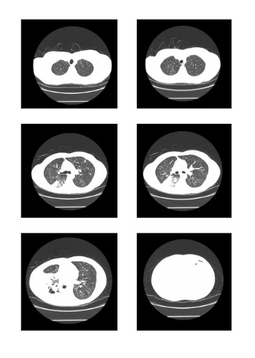
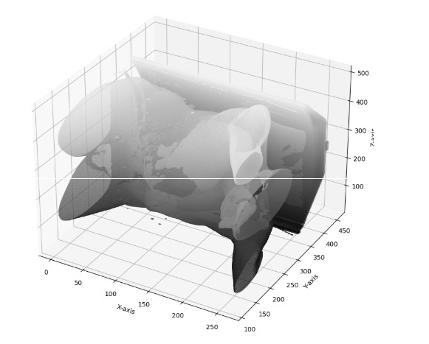
Methodology
Random 2D lung Slices of a Person
After Converting it to 3D Image

Slide 13
Models
ResNet-50 3D: Used MedicalNet ResNet-50, a 3D Convolutional Neural Network (CNN) optimized for medical imaging.
Why ResNet-50?
Handles 3D spatial relationships better than 2D models. Pretrained on medical data, making it more suitable for radiological images. Residual connections help in training deeper models without vanishing gradients.

Slide 14
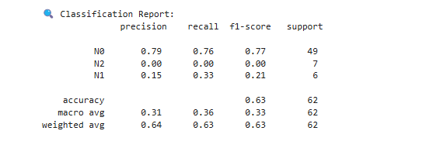
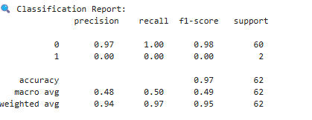
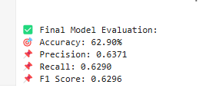
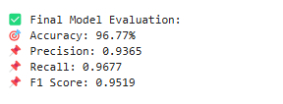
Model Validation

Slide 15
Challenges
Processing and training on large DICOM datasets demanded significant computational resources, including high-end GPUs/TPUs, which were not always readily available.
Training deep learning models on such large and complex datasets took a considerable amount of time, often requiring hours or even days to complete.
Fine-tuning the model to achieve satisfactory accuracy was challenging, requiring extensive hyperparameter optimization and experimentation.
Handling and preprocessing a large volume of DICOM files while ensuring data integrity and consistency added to the complexity.

Slide 16
References
Nam, J. G., Kim, J. E., Yoon, S. H., Lee, S., Kim, N. H., Kim, H. Y., ... & Goo, J. M. (2021). Lung cancer screening with deep learning: The DLAD system. Radiology.
B. Lambin, P., Rios-Velazquez, E., Leijenaar, R., Carvalho, S., van Stiphout, R. G., Granton, P., ... & Dekker, A. (2012). Radiomics: The bridge between medical imaging and personalized medicine. Nature Reviews Clinical Oncology, 9(12), 749-762.
C. Ardila, D., Kiraly, A. P., Bharadwaj, S., Choi, B., Reicher, J. J., Peng, L., ... & Shetty, S. (2019). Artificial intelligence in lung cancer diagnosis: Challenges and opportunities. Nature Medicine, 25(6), 1019-1025.
D. Hesamifard, E., Takabi, H., Ghasemi, M., & Jones, C. (2017). Privacy-preserving machine learning as a service using homomorphic encryption. Proceedings of the 2017 ACM Workshop on Artificial Intelligence and Security, 36-45.
IT21374524| Waseek M.L.
Project ID: 24-25J-211
2025/03/19

Slide 17


Research Gap
Aspect Research | Deep Learning for Lung Cancer Detection | Feature Extraction in Lung Cancer | Homomorphic Encryption in Healthcare | AI Integration in Lung Cancer Detection | NSCLC 360
Research A
Research B
Research C
Research D
IT21374524 | Waseek M.L.
2025/03/19

Slide 18

Methodology – Technologies & Techniques
Technologies
Techniques
Python language
Python libraries
Tensorflow
VS Code
Dicom Image viewer
Machine Learning
Deep Learning
Optimization
IT21374524 | Waseek M.L.

Slide 19
IT21190698 | Arudchayan P.
BSc (Hons) Information Technology Specializing in Data Science Secure
A Novel Explainable Approach for Enhancing Prognostic Analysis in Non-Small Cell Lung Cancer
IT21190698 P Arudchayan
Project ID: 24-25J-211
2025/03/19

Slide 20
Research Question
How can a novel explainable approach leveraging omics data enhance prognostic analysis in non-small cell lung cancer?
IT21190698 P Arudchayan
Project ID: 24-25J-211
2025/03/19

Slide 21
METHODOLOGY
1.DATASET OVERVIEW
2.FEATURE SELECTION
3.MODEL ARCHITECTURES
4.LITERATURE REVIEW
5.TRAINING PROCESS
6.FINDINGS
7.EXPLAINABILITY
8.OBJECTIVES
9.FUTURE WORK
IT21190698 P Arudchayan
Project ID: 24-25J-211
2025/03/19

Slide 22
DATASET OVERVIEW
TCGA-LUAD (The Cancer Genome Atlas - Lung Adenocarcinoma) is a dataset from The Cancer Genome Atlas (TCGA) project, focused on Lung Adenocarcinoma (LUAD), one of the most common subtypes of non-small cell lung cancer (NSCLC).
Dataset Overview:
Type: Genomic and clinical data
Samples: Over 500 lung adenocarcinoma tumor samples.
Data Modalities:
Genomic: Whole-exome sequencing (WES), whole-genome sequencing (WGS)
Transcriptomic: RNA sequencing (RNA-Seq)
Epigenomic: DNA methylation profiles
Proteomic: Reverse-phase protein arrays (RPPA)
Clinical Data: Patient demographics, tumor stage, survival outcomes, and treatment responses
Pathology: Histopathology images
Mutation Data: Somatic mutations, copy number variations (CNVs), structural variants
IT21190698 P Arudchayan
Project ID: 24-25J-211
2025/03/19

Slide 23
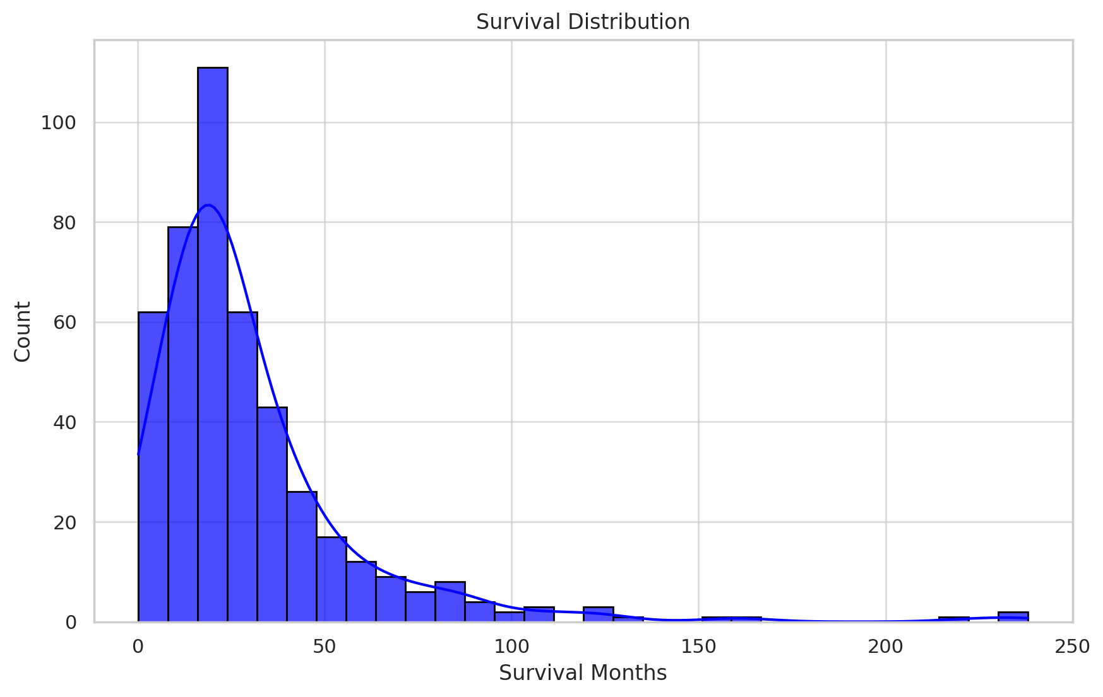
DATASET OVERVIEW
IT21190698 P Arudchayan
Project ID: 24-25J-211
2025/03/19

Slide 24
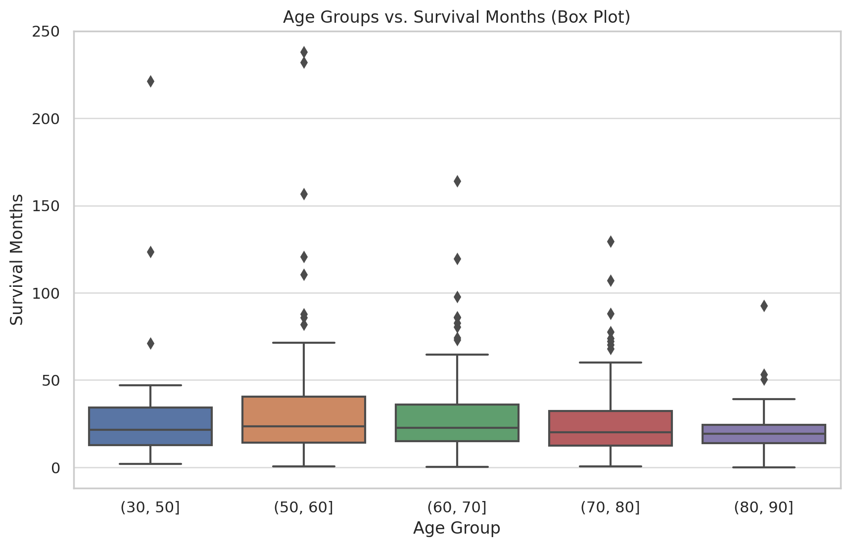
DATASET OVERVIEW
IT21190698 P Arudchayan
Project ID: 24-25J-211
2025/03/19

Slide 25
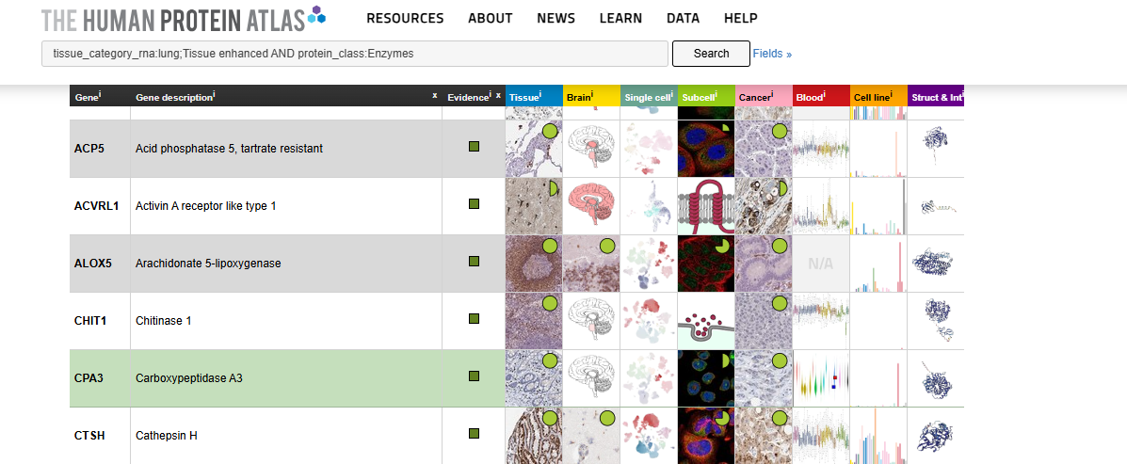
FEATURE SELECTION
The dataset originally contained over 2,800 features, comprising a mix of RNA-Seq (rnaseq), mutation (mut), and copy number variation (cnv) data. Given the high dimensionality, we implemented a feature selection strategy to enhance interpretability and reduce redundancy.
To incorporate biological and clinical relevance, we leveraged the Human Protein Atlas, which provides a curated list of proteins known to be prognostic in cancer. Using this resource, we applied a clinical knowledge-based feature selection approach, prioritizing genes with established associations to cancer progression and outcomes.
IT21190698 P Arudchayan
Project ID: 24-25J-211
2025/03/19

Slide 26
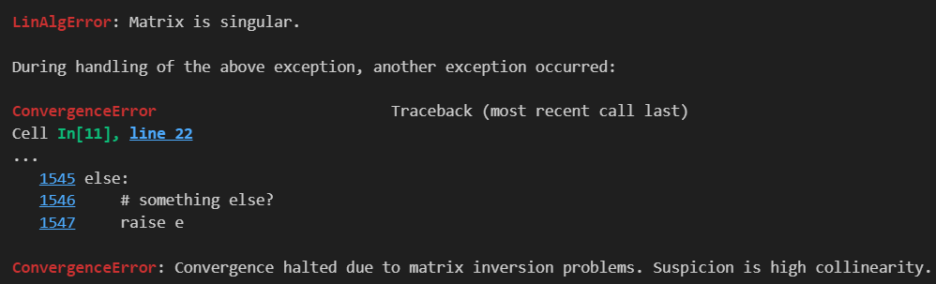
FEATURE SELECTION
However, after selection, the dataset still exhibited high feature correlation, mainly due to:
Strong similarities in gene expression values, where certain genes show highly correlated expression patterns.
Variability in scale across different feature types, as mutation, copy number, and RNA expression data are measured in different units.
To mitigate these issues, we applied standard scaling to normalize the feature distributions, ensuring comparability across different data types.
IT21190698 P Arudchayan
Project ID: 24-25J-211
2025/03/19

Slide 27
MODEL ARCHITECTURES
L1-Penalized Cox Proportional Hazards Model (Lasso-Cox)
The L1-penalized Cox model, also known as the Lasso-Cox model, introduces an L1 regularization term into the classical Cox Proportional Hazards (CoxPH) model. This approach is useful when dealing with high-dimensional datasets where variable selection and model sparsity are desirable. For the L1-penalized Cox model, we introduce an L1 penalty (Lasso penalty) on the regression coefficients:
The L1 penalty forces some coefficients to be exactly zero, effectively performing variable selection.
IT21190698 P Arudchayan
Project ID: 24-25J-211
2025/03/19

Slide 28
TRAINING PROCESS
Training Process
All models were trained with hyperparameter tuning (HP tuning) to optimize performance. Given that the models have widely differing interpretations, objectives, and theoretical foundations, the training process was tailored to each model based on its unique characteristics and literature guidelines.
However, the primary evaluation metric was the Concordance Index (C-index), which measures the model's ability to correctly rank survival times based on risk scores. A higher C-index indicates better predictive performance, as it reflects how well the model distinguishes between patients with different survival outcomes.
Each model was trained and validated using cross-validation strategies to ensure robustness and generalizability across different patient cohorts.
IT21190698 P Arudchayan
Project ID: 24-25J-211
2025/03/19

Slide 29
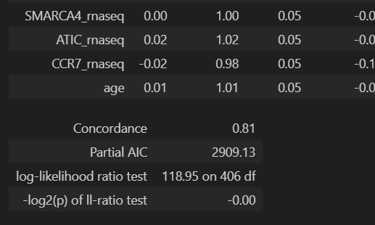
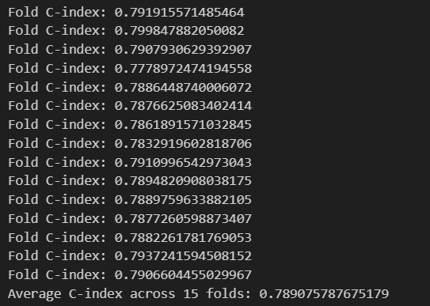
TRAINING PROCESS
IT21190698 P Arudchayan
Project ID: 24-25J-211
2025/03/19

Slide 30
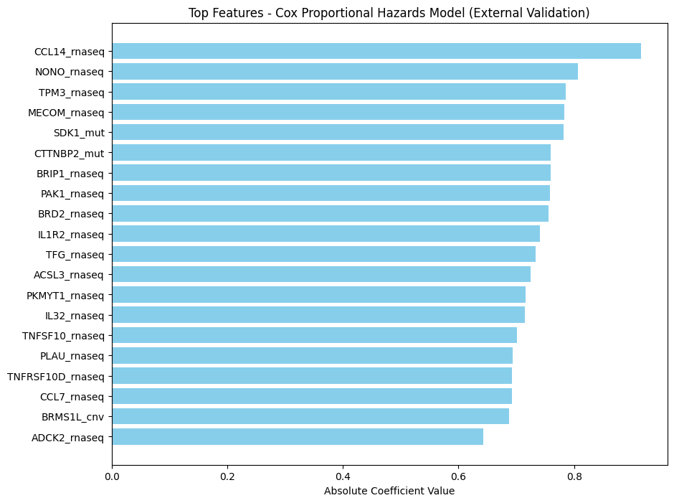
EXPLAINABILITY
IT21190698 P Arudchayan
Project ID: 24-25J-211
2025/03/19

Slide 31
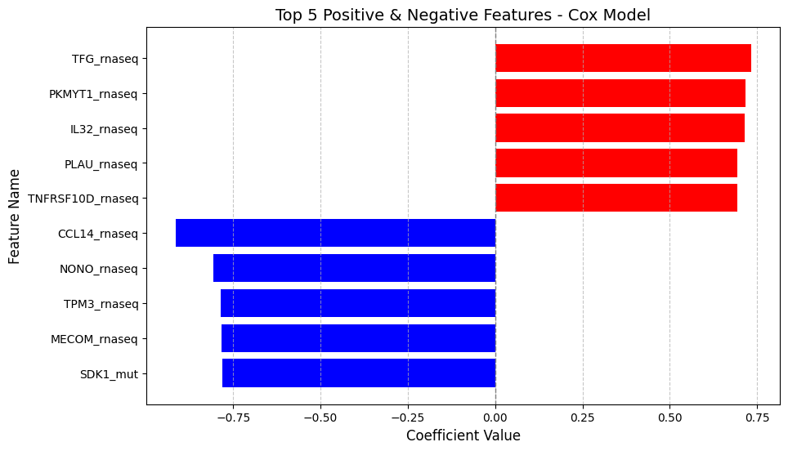
EXPLAINABILITY
IT21190698 P Arudchayan
Project ID: 24-25J-211
2025/03/19

Slide 32
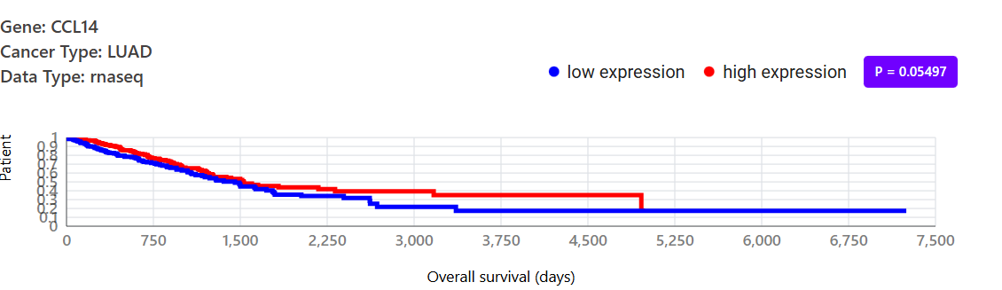
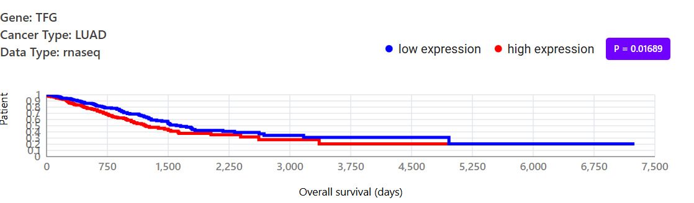
Kaplan Meier Plots
IT21190698 P Arudchayan
Project ID: 24-25J-211
2025/03/19

Slide 33
OBJECTIVES
Develop a prognostic model that integrates multi-omic data (e.g., genomics, transcriptomics, proteomics) to predict patient outcomes, such as survival, disease progression, and treatment response, while ensuring the model is interpretable and actionable in clinical settings.
Identify novel biomarkers that correlate with patient prognosis, utilizing multi-omic data integration to uncover hidden relationships and predictive signals.
Develop a standardized, scalable process for integrating multi-omic data to build prognostic models and identify biomarkers, ensuring the methodology is replicable and can be applied across different types of cancers.

Slide 34

FUTURE WORK
Expand Data Collection Across Diverse Populations: Broaden data collection efforts to encompass a wider variety of demographic groups, ensuring enhanced model performance and generalizability across different populations.
Integrate with Existing Systems: Develop seamless integrations with existing healthcare systems to facilitate efficient data exchange and improve the scalability and applicability of predictive models.
Implement Additional Industry-Relevant Features: Incorporate additional features and variables that are critical to industry requirements, ensuring the model addresses emerging needs and enhances its practical utility in clinical settings.

Slide 35
IT2342226 | AHAMED A.S.S
BSc (Hons) Information Technology Specializing in Data Science Secure
Machine learning for Non-Small Cell Lung Cancer complication Prediction
IT21342226 | Ahamed A.S.S
Project ID: 24-25J-211
2025/03/19

Slide 36
Research Question
How can we accurately predict Complication in lung cancer (NSCLC) leveraging patient Diagnostic and treatment specific data and modeling techniques, to optimize treatment strategies and improve overall patient outcomes?
IT21342226 | Ahamed A.S.S
Project ID: 24-25J-211
2025/03/19
IT21342226 | Ahamed A.S.S
2025/03/19

Slide 37
Challenges
Identifying a suitable dataset that matches the component topic
Preprocessing the medical dataset with careful medical knowledge
Identifying a suitable model and making the prediction
IT21342226 | Ahamed A.S.S
Project ID: 24-25J-211
2025/03/19
IT21342226 | Ahamed A.S.S

Slide 38
Specific Sub-Objectives
To identify key factors influencing Complication through feature engineering and analysis.
Enhance the of Complication prediction with the potential Data collected ….
Enhance the built machine learning models
IT21342226 | Ahamed A.S.S
Project ID: 24-25J-211
2025/03/19
IT21342226 | Ahamed A.S.S

Slide 39

Methodology – Requirements
Expertise in data science, machine learning, and clinical research. Strong communication and collaboration skills to work effectively with medical professionals.
Accuracy
Scalability
Security
Performance
Usability
Data Collection
Model Training
Side effect prediction
User interface
Report generation
IT21190698 P AhamedA.S.S
Project ID: 24-25J-211
2025/03/19

Slide 40
Dataset and Techniques
A dataset was obtained from the PLCO Lung Dataset, along with its data dictionary. Accessing this dataset required a lengthy process.
Dataset was available with more tha 260 variables and above a 100 thousand rows. And it is cleaned and preproccsed to 25000 rows and 33 columns
Various preprocessing techniques are used. Like techniques for data balancing label encoding, data label encoding. Feature engineering are used.
Various models like tabnet classifier, Random forest classification, Xgboost, Decision tree are used and finally came up with more accurate model Random forest classification.
ITxxxxxxx
IT21342226 | Ahamed A.S.S
Project ID: 24-25J-211
2025/03/19

Slide 41
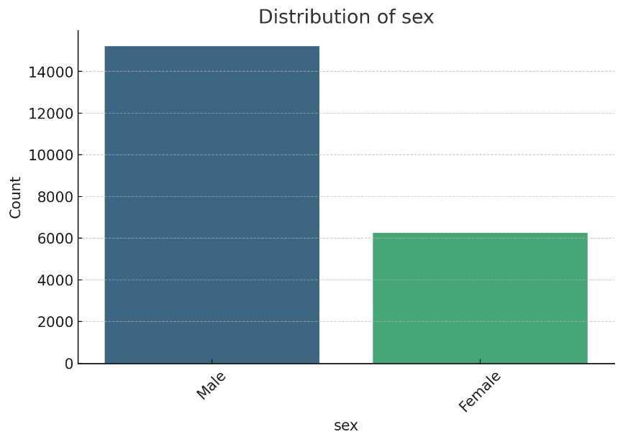
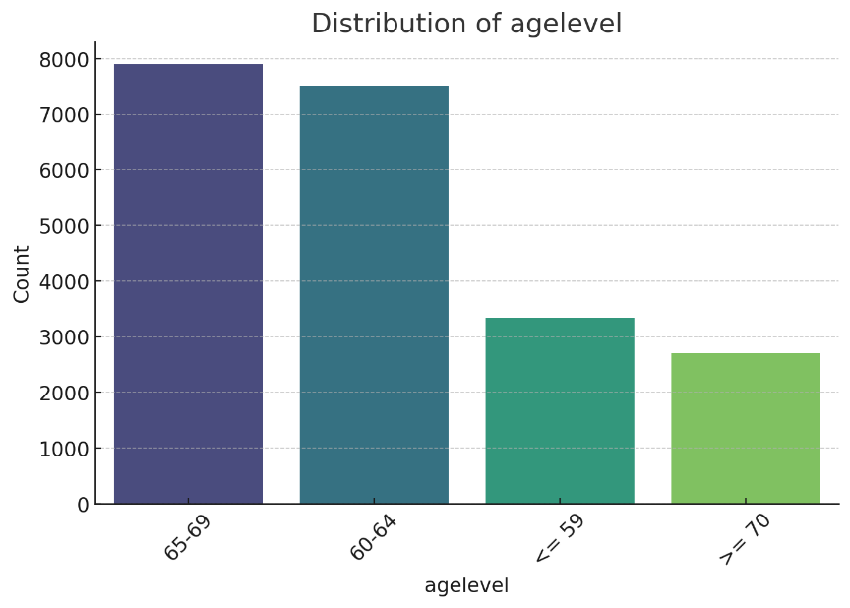
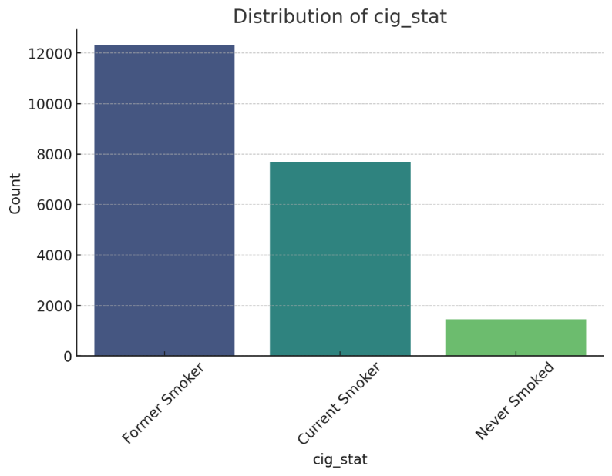
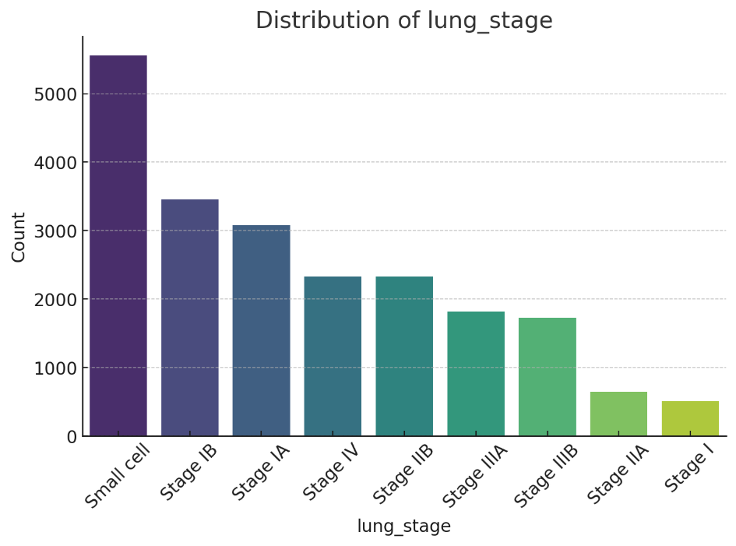
Data Visualization
IT21190698 P Arudchayan
Project ID: 24-25J-211
2025/03/19

Slide 42
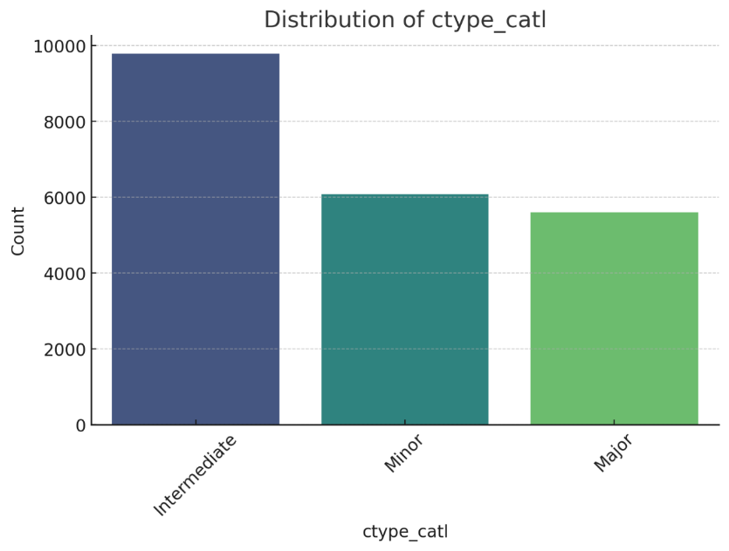
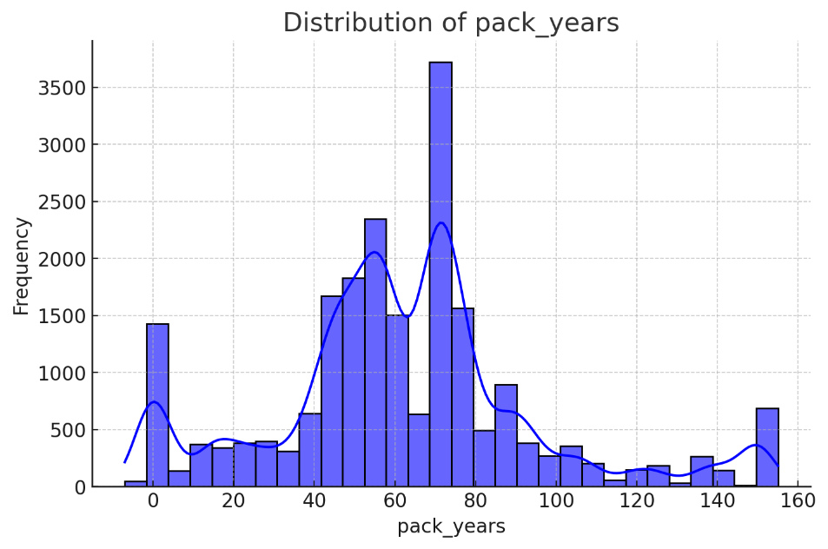
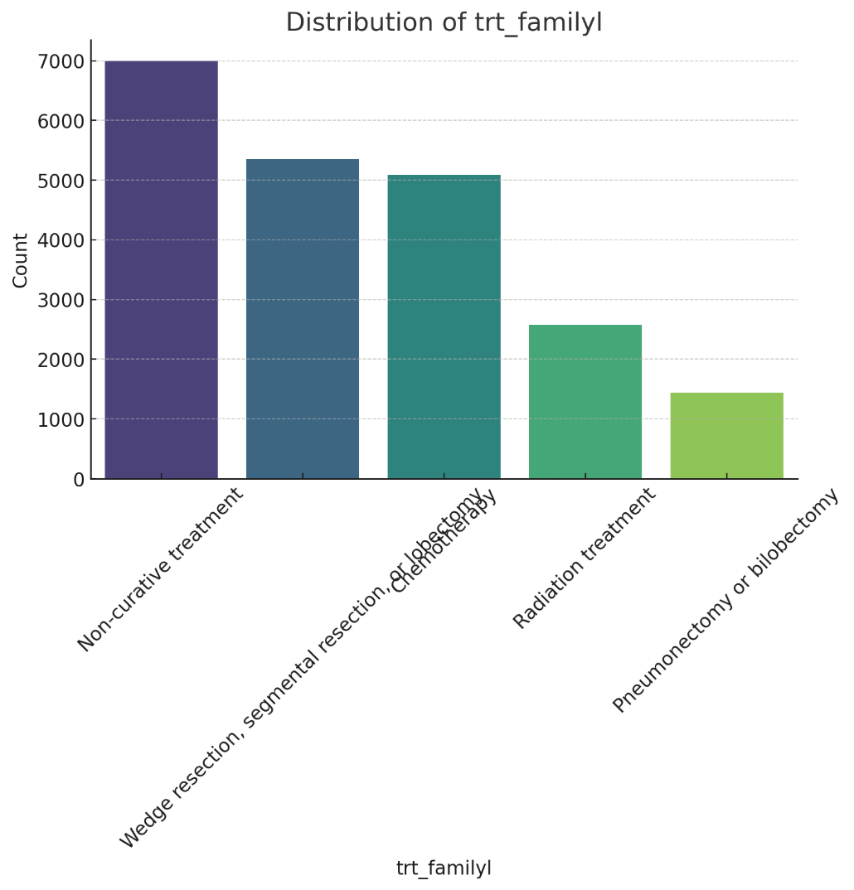
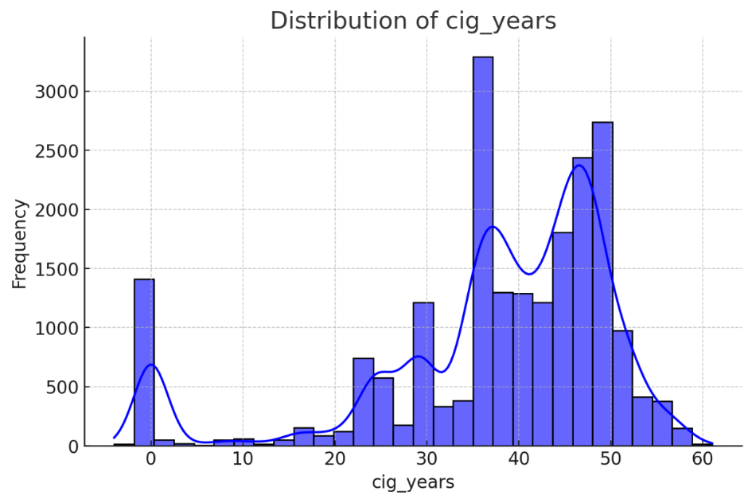
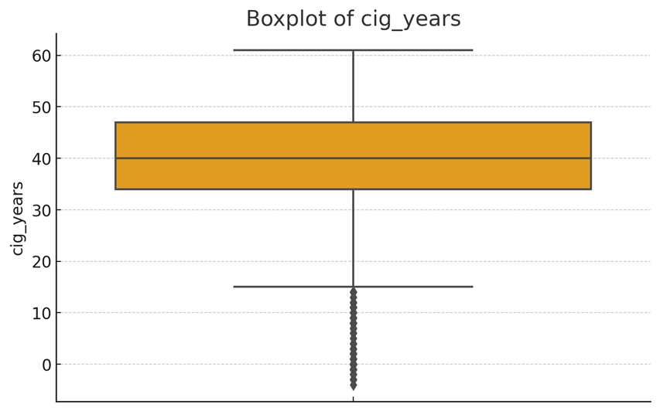
Data Visualization
IT21190698 P Arudchayan
Project ID: 24-25J-211
2025/03/19

Slide 43
Research Gap
Aspect Research | Lung Cancer Comp | Complications other cancer | Prediction of Severity of the Lung cancer | Lung Cancer complication gap | NSCLC 360
Identified compatible Dataset
Using Machine Learnig
Predicting Different Variables
Integrating Different Models
Integrating to Large System
ITxxxxxxx
IT21342226 | Ahamed A.S.S
Project ID: 24-25J-211
2025/03/19

Slide 44
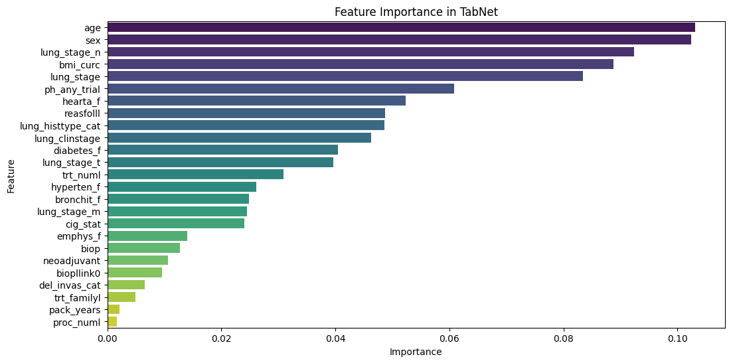
Feature importance

Slide 45
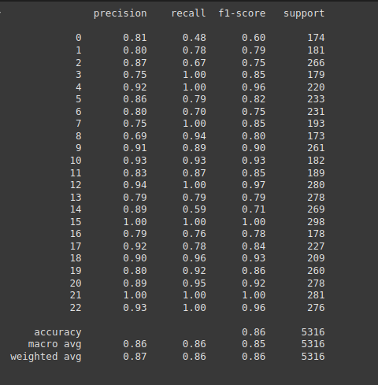
Validation accuracy report

Slide 46
Methodology – Technologies & Techniques
Technologies
Techniques
Python language
Python libraries
Tenserflow
VS Code
Google Colab
Machine Learning
Deep Learning
NLP
Optimization
ITxxxxxxx
IT21342226 | Ahamed A.S.S
Project ID: 24-25J-211
2025/03/19

Slide 47

References
Mazzocco, T., & Hussain, A. (2011). A side-effects mapping model in patients with lung, colorectal and breast cancer receiving chemotherapy. 2011 IEEE 13th International Conference on e-Health Networking, Applications and Services. This study provides valuable insights to medical and nursing staff for predicting chemotherapy side effects, enabling them to select appropriate interventions to minimize symptom impact.
Srinivas, T. A. S., Monika, M., Aparna, N., Narasimha Rao, C., & Ramprabhu, J. (2023). A Methodology to Predict the Lung Cancer and its Adverse Effects on Patients from an Advanced Correlation Analysis Method. 2023 International Conference on Intelligent Data Communication Technologies and Internet of Things.
Fletcher, C., Wilson, C. J., Hutchinson, A., & Grunfeld, E. (2018). The relationship between anticipated response and subsequent experience of cancer treatment-related side effects: A meta-analysis comparing effects before and after treatment exposure. Cancer Treatment Reviews.
It21331022 | Irfan N.A.A
Project ID: 24-25J-211
2025/03/19

Slide 48
Research Objectives
Identifying features for predicting recurrence of cancer using ML models.
Identifying features for predicting new cancer event type using ML models
Identifying features for predicting Progression Free Interval time using Survival Models
Provide Interpretability with important features identified for each prediction
IT21331022 Irfan N.A.A
Project ID: R24-071
2025/03/19

Slide 49
Data Set Overview
TCGA database for phenotype data of patients. Providing PFI , PFI.time and etc
Porpoise Dataset for genomic Data of patients specifically catered for prediction of survivability and interpretability.

Slide 50
Methodologies
Using the human protein index the necessary genes for recurrence prediction were filtered
Preprocessing phenotype and genotype dataset for all available patients , with scaling and encoding for numerical and categorical columns as well as handle missing data.
Use separate models for each datasets and integrate the outputs of each model to the next tier.
Provide Feedback with most important features used along with probabilities for binary and non-binary predictions.

Slide 51
ML models used
Cox Proportional Hazard Model for PFI time
Random Forest Tree Classifier for event type and recurrence prediction

Slide 52
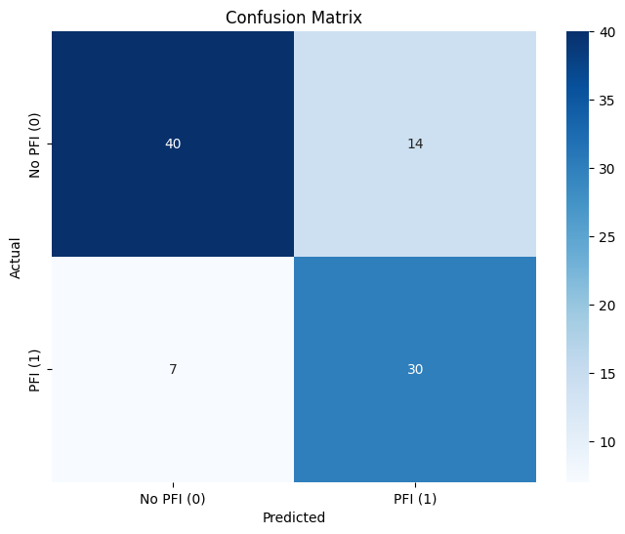
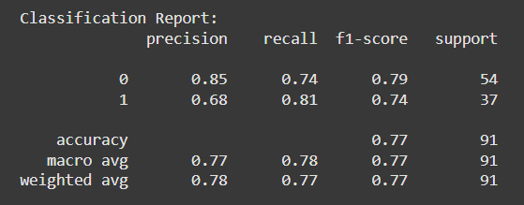
Results and Interpretation
The recurrence prediction RandomForestClassifier model was fitted with 10 folds and after hyper-parameter tuning achieved the below performance

Slide 53
Top Ten Important features
new_tumor_event_type_encoded | 0.1669
treatment_outcome_first_course_encoded | 0.0132
GDF10_rnaseq | 0.0113
SCYL1_rnaseq | 0.0105
NACA_rnaseq | 0.0102
GMFB_rnaseq | 0.0095
ajcc_pathologic_tumor_stage_encoded | 0.0090
SLAMF1_rnaseq | 0.0088
FIP1L1_rnaseq | 0.0081
SLC44A1_rnaseq | 0.0080

Slide 54
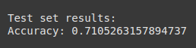
Results and Interpretation
The new event type prediction RandomForestClassifier model was cross validated and achieved a test set accuracy of 0.71053
Top Ten Important features
CBLC_rnaseq | 0.025176
PIK3R1_rnaseq | 0.014466
CDKL2_rnaseq | 0.013736
EPHB3_rnaseq | 0.013419
TNFRSF10C_rnaseq | 0.013119
NMB_rnaseq | 0.012321
SEMA3C_rnaseq | 0.011983
CD300A_rnaseq | 0.011635
CXCL17_rnaseq | 0.011379
STK3_rnaseq | 0.011353

Slide 55
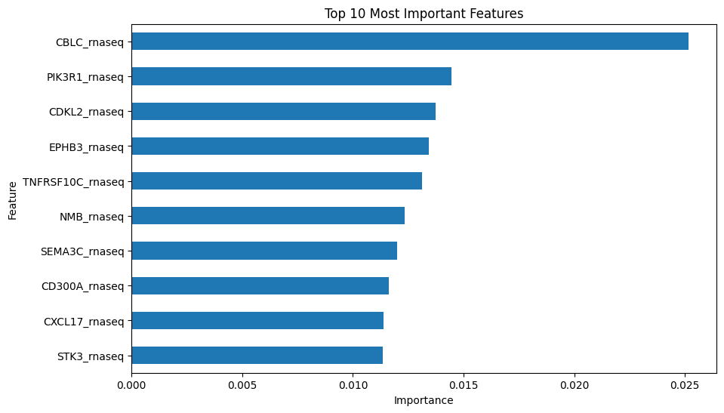

Slide 56
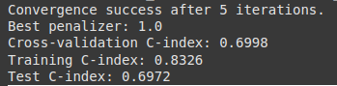
Results and Interpretation
The Progression Free Interval time prediction was done with a CoxPHFitter model
Top Ten Important features
new_tumor_event_type_encoded | 0.1408
CDK6_rnaseq | 0.0635
ANPEP_rnaseq | 0.0589
BIRC3_rnaseq | 0.0586
EPHB2_rnaseq | 0.0491
treatment_outcome_first_course_encoded | 0.0478
RPN1_rnaseq | 0.0469
HSP90AA1_rnaseq | 0.0464
is_female | 0.0443
ITGA5_rnaseq | 0.0411

Slide 57
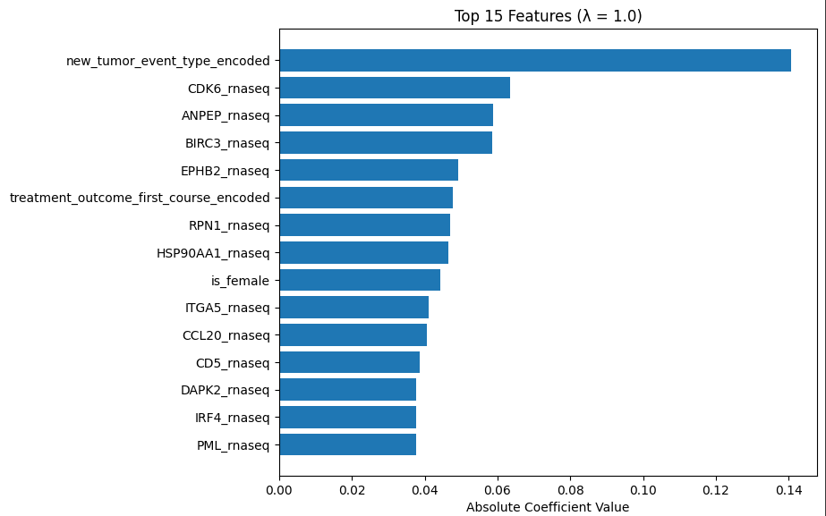

Slide 58
ML model tiering
The first model is the RandomForest Classifier which uses the inputs to predict new cancer event type.
The second model then uses the new cancer event type as an input and predicts recurrence as the probability of PFI
The third model which is the CoxPH model thus predicts the PFI time
All the models output predictions with interpretability in the columns that were significant and return a probability value.

Slide 59
THANK YOU
Project ID: R24-071
2025/03/19

